Slide 1


Social Buzz
Content Analytics

Slide 2


Today's agenda
Project recap
Problem
The Analytics team
Process
Insights
Summary

Slide 3

Social Buzz is a fast growing technology unicorn that need to adapt quickly to it's global scale.
Accenture has begun a 3 month POC focusing on these tasks:
An audit of Social Buzz's big data practice
Recommendations for a successful IPO
Analysis to find Social Buzz's top 5 most popular categories of content
Project Recap

Slide 4

Problem
The client has reached a massive scale within recent years and does not have the resources internally to handle it.

Slide 5



ANDREW FLEMING
Chief Technology Architect
The Analytics team
MARCUS ROMPTON
Senior Principal
Myself
Data Analyst

Slide 6
Process
1
Data Understanding
2
Data Cleaning
3
Data Modelling
4
Data Analysis
5
Uncover Insights

Slide 7

Insights
16
04
Animals
UNIQUE
CATEGORIES
CONTENT
TYPE
MOST POPULAR
CATEGORY

Slide 8
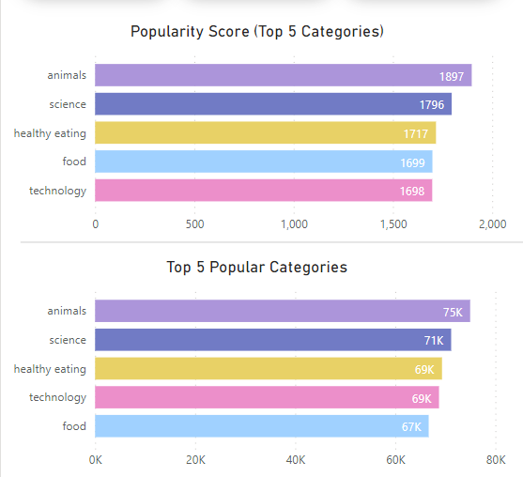

Slide 9
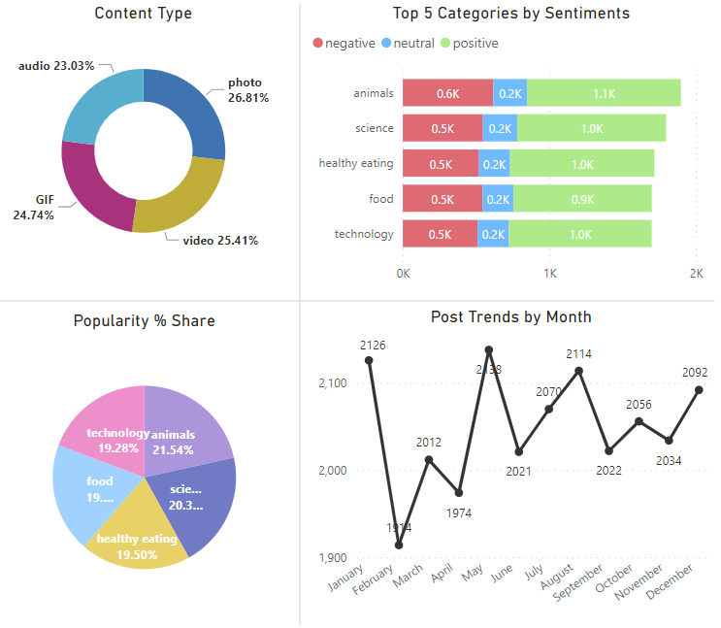

Slide 10

Capitalize on the popularity of ‘Animals’ and ‘Science’ by consistently creating “real-life” and “factual” content in these categories to maintain and enhance user engagement.
‘Healthy Eating’ is a prominent theme within the top 5 categories. Consider launching a targeted campaign and collaborating with healthy eating brands to further boost user engagement, leveraging this audience interest.
The presence of ‘Technology’ content indicates user enjoyment in this category. Explore partnerships with tech industry leaders to significantly increase user engagement, aligning with the rise in technology trends.
Summary

Slide 11
Thank you!
ANY QUESTIONS?

